Slide 1

Audience Activator
POWERED BY FULLTHROTTLE.AI
CONVERTING YOUR AUDIENCE
Notes:
Nexstar has partnered with Fullthrottle.ai
Ask about:
# of monthly uniques/new site visitors
Goals/challenges

Slide 2


AUDIENCE ACTIVATOR
Expand Your Sales Cycles
Capturing Web Visitor Data
| For most websites, less than 5% will fill
out a form or make direct contact with
your business.
| Audience Activator captures opt-in
user data and delivers a high
frequency marketing campaign to
shopper households.
When Does The Sales
Process Begin?
Notes:
When does your business begin the sales process? (Talk track)
Your sales team is available to connect with customers when they visit your store or complete an online form.
Most businesses have limited or no capability to connect with customers who visit their website but don’t make contact.
Industry Challenge
Auto dealers face intense local competition – dealerships just blocks apart.
Traditional lead capture (form fills) only identifies ~5% of website visitors.
95% of visitors remain anonymous, representing lost opportunity.
On average 2% to 5% of website visitors fill out a form or contact the business. This means that 95% or more of your website visitors will never connect with your sales team.
Our Incremental first party data system can capture and market to the 95% to 98% of your customers who don’t connect with you directly. This improves your chances of converting customers most likely to purchase from your company.

Slide 3

AUDIENCE ACTIVATOR
What Is The Audience Activator?
Audience Activator is your toolkit for next-generation targeting, engagement, and attribution.
Incremental First Party Data
We capture and verify household information for visitors to your website.
AI Prioritization
Our intelligent platform tracks user activity then categorizes and prioritizes targets.
Addressable Targeting
We deliver a high-frequency media campaign to your first-party audience.
Notes:
The Solution: Audience Activator
Captures anonymous web visitors before they submit a lead.
Converts first-party web traffic into targetable households.
Enables real-time audience engagement via AI and omnichannel delivery.
Core Components
Incremental First-Party Data
Identifies and targets anonymous shoppers at the household level.
AI-Powered Prioritization
Determines likely buyers using AI in milliseconds.
Ask what they are currently running? Add that Shopper Suite will compliment their existing strategies.
Omnichannel Household Targeting
Reaches entire homes across:
Mobile, tablet, desktop
CTV/streaming TV
Personalized direct mail (delivered within 24 hrs)
________________________________________________________
Audience Activator utilizes opt-in location data to connect mostly anonymous web visitors with household data.
We use Artificial Intelligence to categorize, and rank your customers based on their stage of the buying cycle and propensity to do business with your company.
We target identified households with direct mail and addressable streaming, video, and display ads.
Note:
Some auto dealers use a Consumer Data Platform (CDP) and will think that Full Throttle is the same thing.
CDPs organize all your data (online and offline), from various 1p and 3p sources, activate media and report. Our tool specifically uses patented tech that transforms your best anonymous website shoppers into households so we target your highest propensity shoppers in your virtual showroom to improve the potential for conversion.
Many companies use a CDP in conjunction with our platform.

Slide 4

AUDIENCE ACTIVATOR
The Retargeting Dilemma
But…Traditional Retargeting is Limited
| Most traditional retargeting strategies
rely on third-party browser cookies.
| Traditional retargeting is limited to
specific devices.
| Due to privacy restrictions, traditional
retargeting may only reach 31% or less
of your website audience!
Audience Activator’s First Party Data Solution Puts Dealerships in Control
of Retargeting!
https://cookie-script.com/blog/how-to-improve-cookie-banner-acceptance-rate#:~:text=The%20average%20cookie%20banner%20acceptance%20rate%20is%2031%25%2C%20But%20it,and%20depends%20on%20the%20website.
Notes:
Why This Matters
Most retargeting today relies on third-party cookies (rapidly being phased out).
Less than 40% of audiences are now influenced by cookies.
Apple & Google privacy changes limit traditional tracking methods.
Audience Activator Advantages
Uses a cookie-free, privacy-compliant script to collect opt-in visitor data.
Prioritizes and targets at the household level – not just the device.
Offers:
400% increase in engagement
1,000% lift with effective retargeting
70% greater likelihood of conversion
Benefits of Retargeting: Retargeting website visitors is proven to lift engagement and organic search while increasing overall conversions.
There are two main challenges with traditional cookie-based retargeting:
It focuses on the device rather than the household.
It can miss two-thirds of potential customers due to privacy limitations.
Audience Activator can identify and target web visitors without the use of cookies. We take retargeting to the next level.

Slide 5

AUDIENCE ACTIVATOR
The First Party Data Advantage
Compare Our Data Solution to Traditional Retargeting
| Our proprietary technologies captures
web visitor information.
| We target your web visitors at the household
level using multiple tactics including CTV,
Video, and Direct Mail!
| Our AI prioritizes your best potential customers
based on website engagement.
| We provide full-funnel attribution.
Notes:
We capture user data based on opt-in location information.
We target at the household level across devices. This adds frequency and loops in family decision influencers.
We use AI to target your most active shoppers and deliver ads to customers most likely to do business with your company.

Slide 6
AUDIENCE ACTIVATOR
The Audience Activator Difference
Most websites only convert 2% to 5% of web visitors. This leads to wasted marketing spend and decreased return on investment.
Improved ROI
As you drive more traffic to your website, our AI data tools and addressable marketing drives conversion.
Attribution
Follow your customer journeys from first click to purchase. No more relying on limited last-touch attribution reporting.
Intelligent Segmentation
Our exclusive AI segments your clients based on purchase potential and product interests.
Notes:
Your Marketing Advantage
Beyond capturing incremental first-party data, Audience Activator makes more efficient use of your data:
* We provide transparent attribution to provide visibility on customer journeys.
* Our AI segments your data for more intelligent targeting and increased conversions.

Slide 7
AUDIENCE ACTIVATOR
Expand Your Conversion Pipeline
Convert Website Visitors to Customers
Audience Activator identifies and ranks web visitors for high-frequency multi-platform targeting at the HOUSEHOLD LEVEL.
We target your best web visitors with a high-frequency campaign using a variety of coop-approved marketing tactics including direct mail, CTV, Online Video, and Display.
Audience Activator drives conversions with customers closest to the point of sale – your web audience!
AWARENESS
Top of the funnel
CONSIDERATION
Middle of the funnel
CONVERSION
Bottom of the funnel
LOYALTY
Notes:
Our marketing team can work with your business to drive new qualified traffic to your website, or we can increase conversion from existing traffic.​
​
As we drive more traffic to your site, Audience Activator facilitates more conversions.​
Audience Activator improves the performance of all marketing channels, even from outside vendors.
As top-funnel marketing drives more traffic to the website, Audience Activator has more opportunity to capture data, deliver analysis, and market to high-value prospects.
Your ROI from all media increases as your able to better convert anonymous web traffic.
Audience Activator expands your opportunity for conversion.
Where traditional marketing funnels don’t begin the conversion process until after a potential customer reaches out, Audience Activator identifies, categorizes, and markets to high-value prospects as soon as they visit your website.
Instead of starting your sales process when a prospect calls or fills out a form, our system engages your best prospects and expands your conversion pipeline.
Benefits for Dealers
Own your digital backyard: See where anonymous visitors come from geographically.
Gain insight into who’s in-market, and where they are in the buyer journey.
Improve ROI and attribution for all ad spend:
CTV
Video
Direct Mail
Display Ads

Slide 8
THE AUDIENCE ACTIVATOR PLATFORM
Data Capture | Marketing | Attribution
Notes:
With Audience Activator, you get access to a platform that details:
Web traffic and marketing sources.
Conversion data.
Much more.
Conversion data (measurement) is clear and simple to follow so you know how your campaign is working.

Slide 9
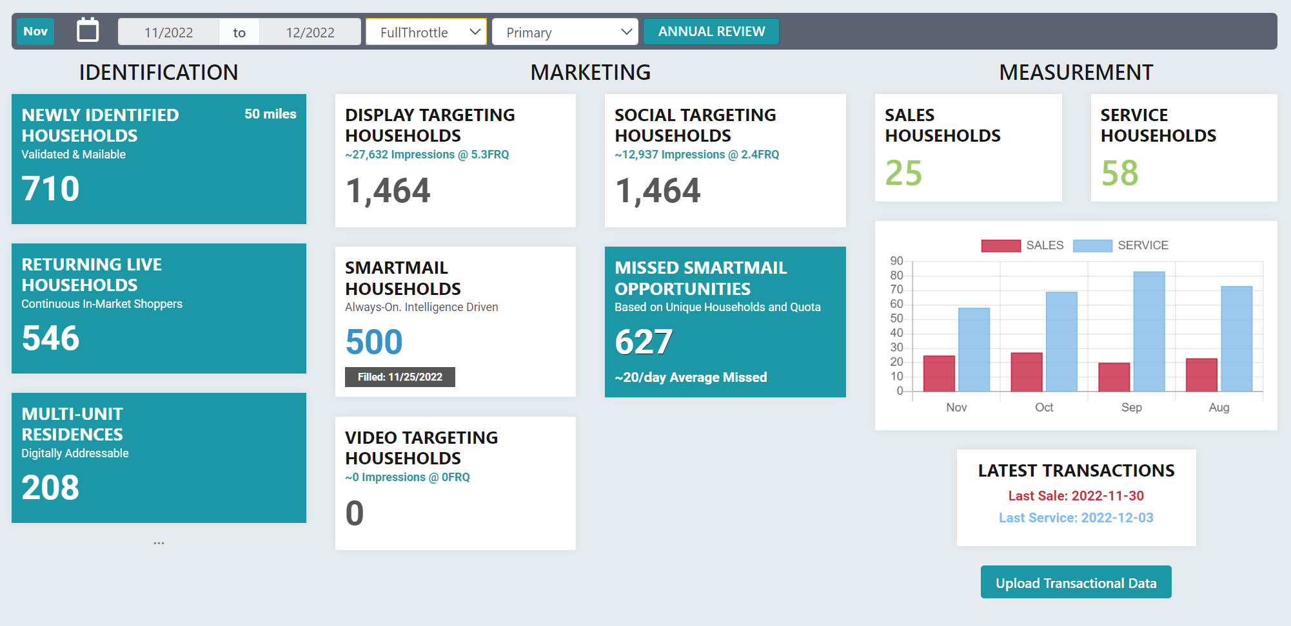
AUDIENCE ACTIVATOR
Comprehensive Reporting
Matched transactions to targeted households

Slide 10
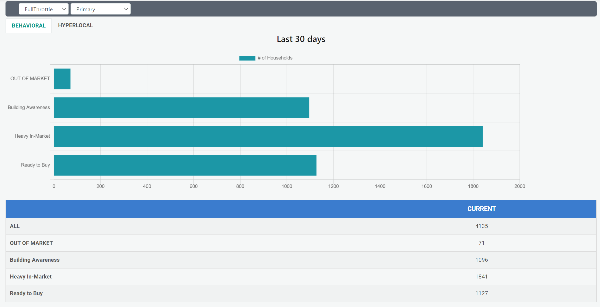
AUDIENCE ACTIVATOR
AI Audience Segmentation
Notes:
Your platform will detail audience segments and customer journeys.

Slide 11
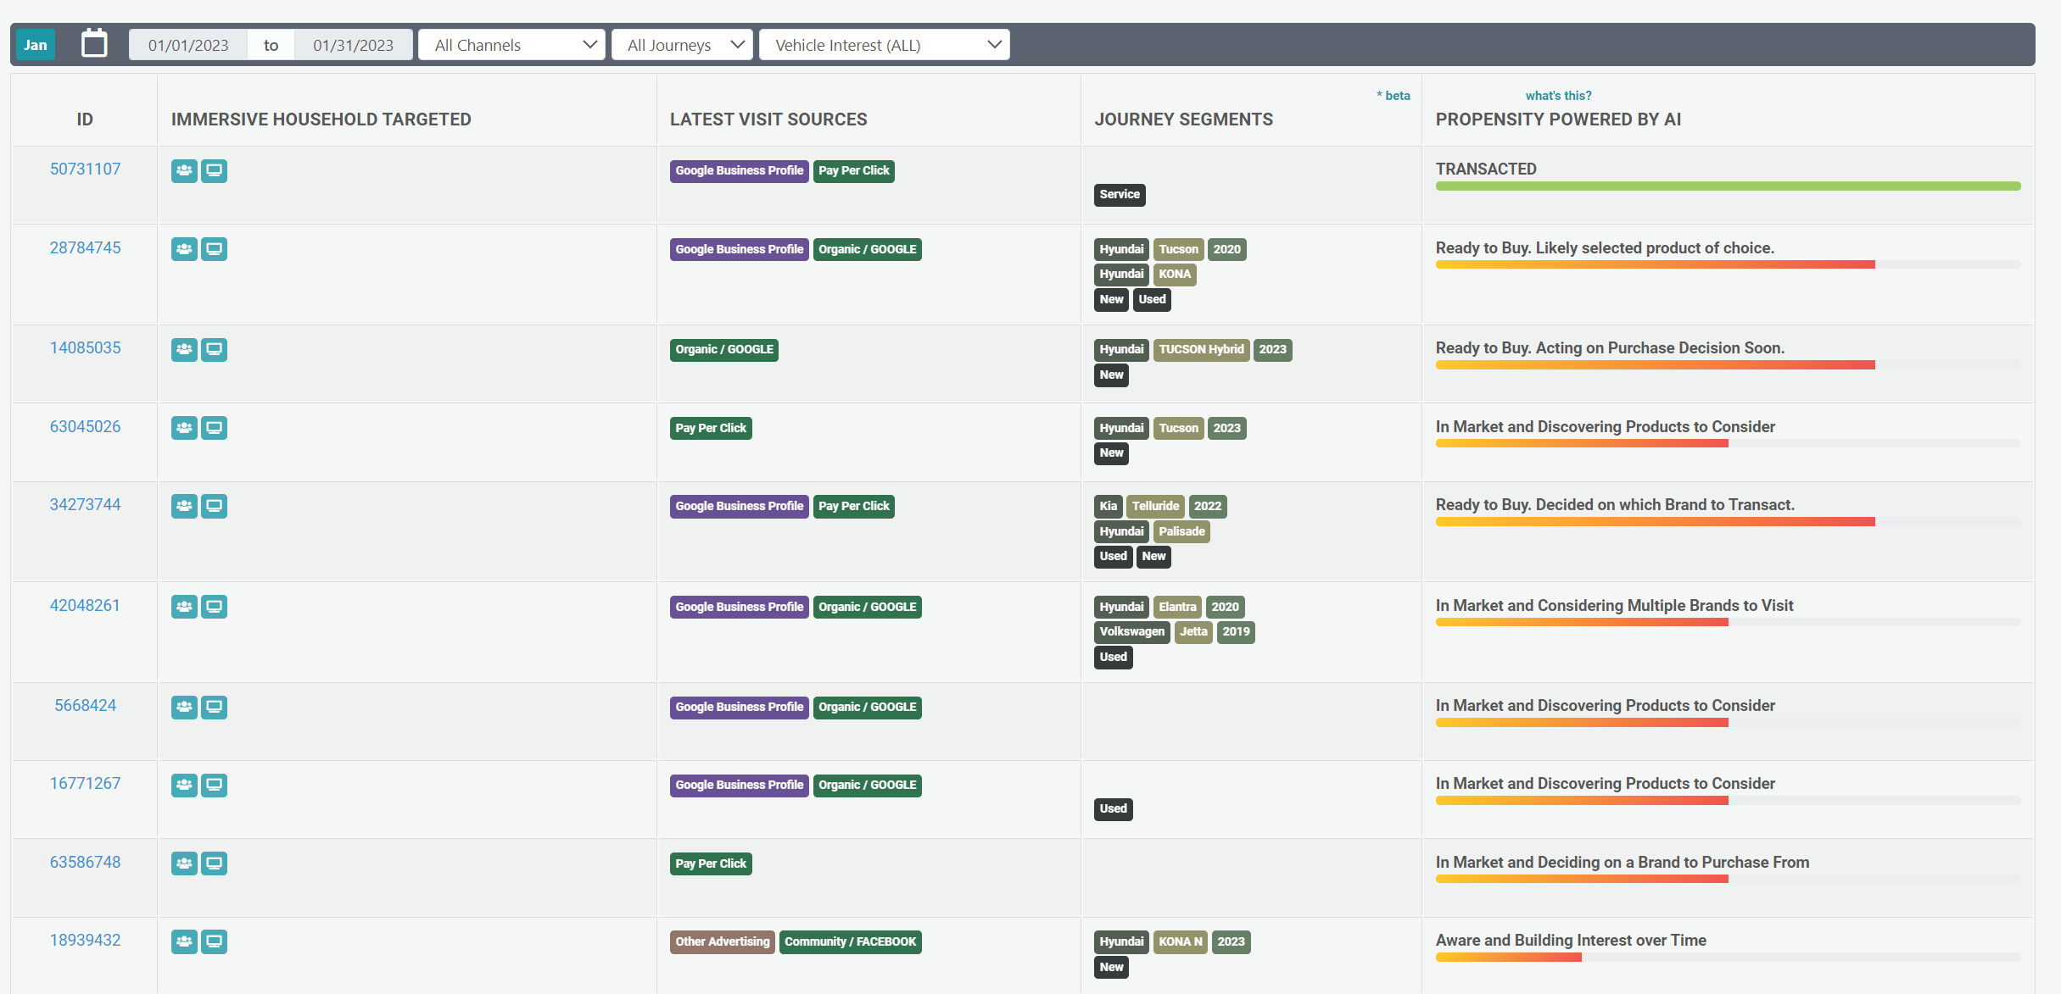
AUDIENCE ACTIVATOR
Household Level Data
Influence – what brought them, when they came, date opted in
Unique data points for predictability
Notes:
We provide fully-transparent and segmented household data.
The latest visit sources provides a full-funnel view of potential/current customers.
Our AI tracks user engagement and categorizes your leads based on propensity to buy.

Slide 12
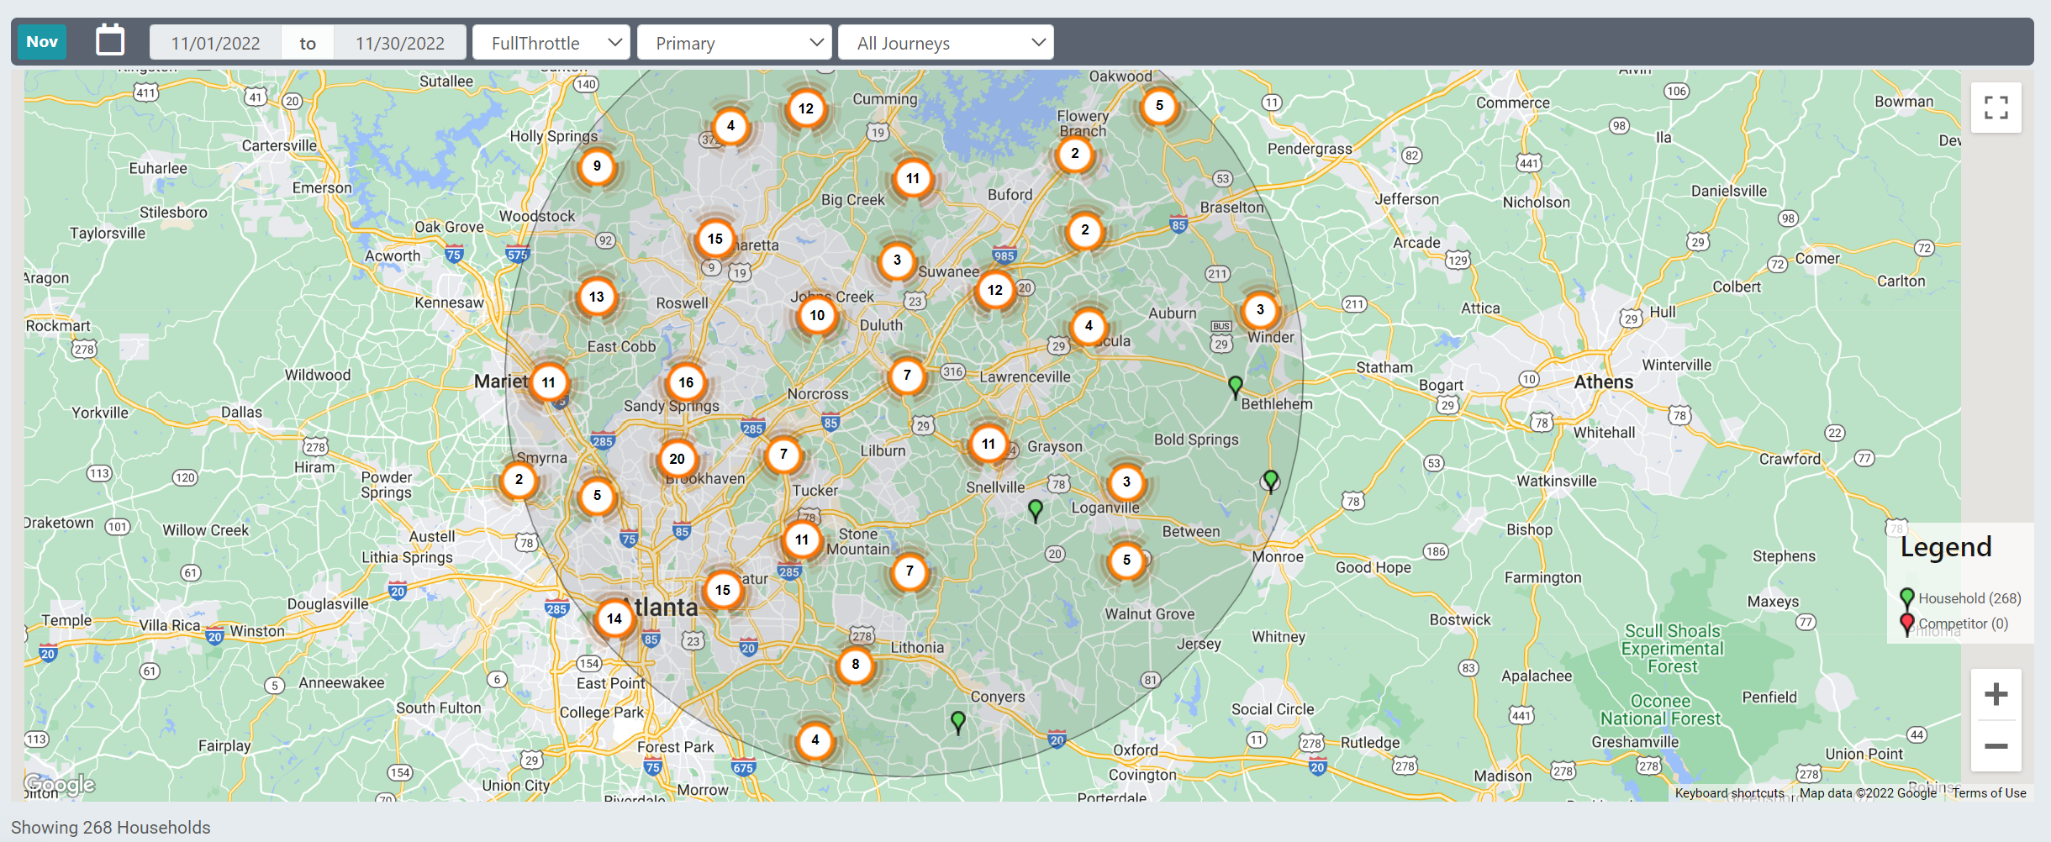
AUDIENCE ACTIVATOR
Map Views & Journey Segments
Notes:
View at the household level or expand for a neighborhood, city, region, or national view of your potential customers.

Slide 13

Start with a TRIAL analysis period that includes complete onboarding & software configuration.
Simply add Audience Activator’s script to your website and it will begin prompting users to opt in and share their location at the browser level.
Three to four weeks after tag placement, our team of experts will meet with you to analyze your results and discuss marketing strategies to help you increase conversions and sales.
Once we agree on a marketing plan, your team will receive credentials to the data platform.
Are you looking for an on-program marketing program? We can develop a strategy for turn-key on-program creative approval and billing.
AUDIENCE ACTIVATOR
Getting Started
The Audience Activator Test Drive
Notes:
Since we customize the marketing strategy for each business, we’re willing to provide your company with a test drive.
As part of the test drive, we’ll analyze existing web traffic and household data. This will provide the based for a potential marketing strategy.
After three to four weeks, we’ll walk you through your data and suggested marketing strategy. Once we agree to a marketing schedule, your company will receive a login to the dashboard.
There’s no risk to your business. All you need to do is place a pixel on your website.

Slide 14


Slide 15

AUDIENCE ACTIVATOR
Present After Marketing Plan is Delivered
Your goal during the initial call is to present Audience Activator to the client and request tag placement.
After three-four weeks, Audience Activator will deliver a customized media plan based on actual client data.
Do not include strategy slides without a custom plan from the Audience Activator team.

Slide 16
YOUR MARKETING STRATEGY
Your Path to Success

Slide 17

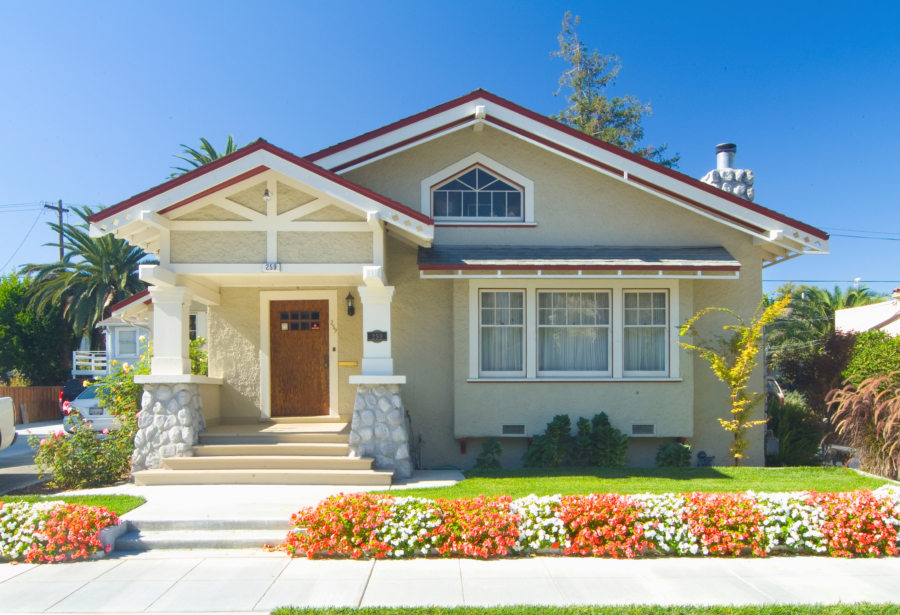



Connected TV
Display
Video
AUDIENCE ACTIVATOR
Addressable & Geo Tactics
Stay Top Of Mind | Stay Relevant
Understand who is visiting a dealer website, verify the HH, show ads on multiple HH devices
Target physical addresses using geo-targeted solution
Brand safe sites and premium inventory
Cross-device capabilities
“Reconnect with shoppers who visit your website, delivering targeted ads to their homes and devices. With precise geo-targeting and premium placements, you stay top of mind, increase showroom visits, and measure real ROI through first-party attribution.”

Slide 18
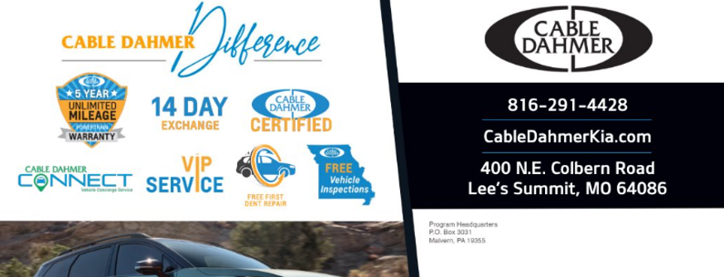

AUDIENCE ACTIVATOR
Smart Mail
Target High Priority Prospects
Smart Mail = Direct Mail
AI technology tracks visitor’s buyer journey
Send Smart Mail immediately following a visitor website visit
Focus creative on Branding and “Why Buy” messaging
Prioritize bottom-funnel site visitors

Slide 19
For Demonstration Only
Do not present.
The Audience Activator Team will deliver a custom strategy based on actual client data.
AUDIENCE ACTIVATOR
My Auto Dealer
AUDIENCE ACTIVATOR
Details
KPIs
Targeting high propensity captured shoppers
Influence on Sales & Service transactions
HH Frequency
Target 3.5 imp/week per Online device
~3 Devices per household
Email one mailer per HH
Geography
Website devices transformed to households
*Rates and Deliverables are estimates to drive business outcomes. As part of the service agreement, adjustments will be made with transparency.
12-month agreement may be cancelled with 30-day’s notice after 90 days.
Channel | Monthly Budget | Target Households | Monthly Cost Per Household
CTV (60% Premium Channels) | $4,366 | 2,000 | $2.18
Addressable Online video (OLV) | $4,140 | 2,000 | $2.07
Addressable Display | $2,688 | 2,000 | $1.34
Nexstar SmartMail | $3,750 | 2,000 | $1.88
AI Platform | $2,000 | 2,000 | $1.00
Total | $16,944 | 2,000 | $8.47
Total Monthly Investment: $16,944
Notes:
Audience Activator is designed to build frequency with your best prospects at the Household Level. Consequently, pricing will be different than traditional large-scale top-of-the-funnel CPM schedules.,
Pricing is based on a household level, rather than typical CPMs.
A typical in-market audience would be much larger than our hyper-targeted first-party shoppers.
Since we are tracking and targeting a smaller audience, often just a few thousand, it costs more to effectively reach and target the audience.
As an example, there might be 1 million devices in play for an auto-intender audience. For this intender audience, you would not need to win a high percentage of available impressions to deliver a campaign.
A first party audience might be a few thousand households which reduces the available inventory to target. This impacts pricing.
Our platform provides full-funnel attribution. It’s not about the impressions, but rather conversions.

Slide 20
AUDIENCE ACTIVATOR
Audience Activator Powered by Full Throttle
Data Security and Terms

