Slide 1

Audience Activator
POWERED BY FULLTHROTTLE.AI
CONVERTING YOUR AUDIENCE
Notes:
Nexstar has partnered with Fullthrottle.ai and has access to a patented AI-powered digital technology, with the ability to identify anonymous website visitors down to Your USPS household level, where we can then deliver targeted digital ads, direct mail, and video media to qualified people in the household across all their devices that are actively shopping on your site – the next best thing to a lead.

Slide 2


AUDIENCE ACTIVATOR
Expand Your Sales Cycles
Capturing Web Visitor Data
| For most websites, less than 5% will fill
out a form or make direct contact with
your business.
| Audience Activator captures opt-in
user data and delivers a high
frequency marketing campaign to
shopper households.
When Does The Sales
Process Begin?
Notes:
Your sales team is available to connect with customers when they complete an online form or pick up the phone and call. But only approximately 5% of your website visitors fill out a lead form. That's a problem. We want to help convert the other 95% into sales or leads for you.

Slide 3



Evolving dealer advertising in 3 ways
Better ad targeting
  95% of your website shoppers aren’t filling out a lead form
  We transform website visitors from an anonymous single device into an immersive Household
  Focus on converting your virtual showroom traffic into sales
Smarter media spending
  Focus dollars on those addressable households. Mitigate media waste
Measure what matters
  Focus on sales and service transactions, not media KPIs
  Use the AI platform to see rich customer journeys & buyer behaviors
Notes:
With our AMM partners, we are evolving the dealer advertising space in 3 ways:
Smarter ad targeting – 95% of your website shoppers aren’t filling out a lead form. We are transforming the outdated “cookie device targeting” to immersive household targeting. Let’s focus on converting more sales opportunities from your virtual showroom.
2. Smarter media spending – focus dollars on those addressable households. Mitigate media waste.
3. Measure what matters – focus on sales and service transactions, not media KPIs. And a platform to see all your customer journeys and buyer behaviors to strategically plan next month’s media investment.

Slide 4

AUDIENCE ACTIVATOR
The Retargeting Dilemma
But…Traditional Retargeting is Limited
| Most traditional retargeting strategies
rely on third-party browser cookies.
| Traditional retargeting is limited to
specific devices.
| Due to privacy restrictions, traditional
retargeting may only reach 31% or less
of your website audience!
Audience Activator’s First Party Data Solution Puts Dealerships in Control
of Retargeting!
https://cookie-script.com/blog/how-to-improve-cookie-banner-acceptance-rate#:~:text=The%20average%20cookie%20banner%20acceptance%20rate%20is%2031%25%2C%20But%20it,and%20depends%20on%20the%20website.
Notes:
We all know that Retargeting website visitors is proven to lift engagement and organic search while increasing overall conversions.
There are three main challenges with traditional cookie-based retargeting:
It focuses on the device rather than the household.
It can miss two-thirds of potential customers due to privacy limitations.
It doesn’t identify a business outcome.
We measure sales data, not just media numbers, to provide business outcomes to the media efforts we deploy.
Audience Activator can identify and target web visitors without the use of cookies. And most importantly, We can get your brand back in front of your site traffic.

Slide 5

AUDIENCE ACTIVATOR
The First Party Data Advantage
Compare Our Data Solution to Traditional Retargeting
| Our proprietary technologies captures
web visitor information.
| We target your web visitors at the household
level using multiple tactics including CTV,
Video, and Direct Mail!
| Our AI prioritizes your best potential customers
based on website engagement.
| We provide full-funnel attribution.
Notes:
We identify, Market and Measure
We capture user data based on opt-in location information.
We target at the household level across devices. We are cross device targeting. This adds frequency and loops in family decision influencers.
We deliver targeted ads and get your brand back in front of your online shoppers through digital, direct mail, and video media to qualified people in the household across all their device.
We use AI to target your most active shoppers and deliver ads to customers most likely to do business with your company.

Slide 6
AUDIENCE ACTIVATOR
Expand Your Conversion Pipeline
Convert Website Visitors to Customers
Audience Activator identifies and ranks web visitors for high-frequency multi-platform targeting at the HOUSEHOLD LEVEL.
We target your best web visitors with a high-frequency campaign using a variety of coop-approved marketing tactics including direct mail, CTV, Online Video, and Display.
Audience Activator drives conversions with customers closest to the point of sale – your web audience!
AWARENESS
Top of the funnel
CONSIDERATION
Middle of the funnel
CONVERSION
Bottom of the funnel
LOYALTY
Notes:
Audience Activator improves the performance of all your marketing channels.
As top-funnel marketing drives more traffic to the website, Audience Activator has more opportunity to capture data, market to the high-value prospects that you are working hard to funnel to your website.
We are not just getting in front of everyone, we are getting in front of the right person at the right time and pushing them down the funnel.

Slide 7
THE AUDIENCE ACTIVATOR PLATFORM
Data Capture | Marketing | Attribution
Notes:
With Audience Activator, you get access to a platform that details:
Web traffic and marketing sources.
Conversion data.
Much more.
Conversion data (measurement) is clear and simple to follow so you know how your campaign is working.

Slide 8










ConnectedTV
Premium video ads within subscription-based streaming TV content that combine traditional TV's impact with digital targeting precision, reaching viewers of highly premium long-form content exclusively on television screens
Publisher Library Sample
The average CTV viewer spends an average of 122 minutes per day watching this streaming content
Immersive Household Experience
Connection Points: Smart TVs, gaming consoles, streaming devices (Roku, Fire TV, etc.)
Life Setting: Living room, Family room, Master bedroom, Basement/media room
Engagement Drivers:
Cinema-like immersion
Shared family viewing experience
Lean-back relaxation mindset
Premium content association with appointment-viewing
Sources: Xumo 2024 FAST Report

Slide 9
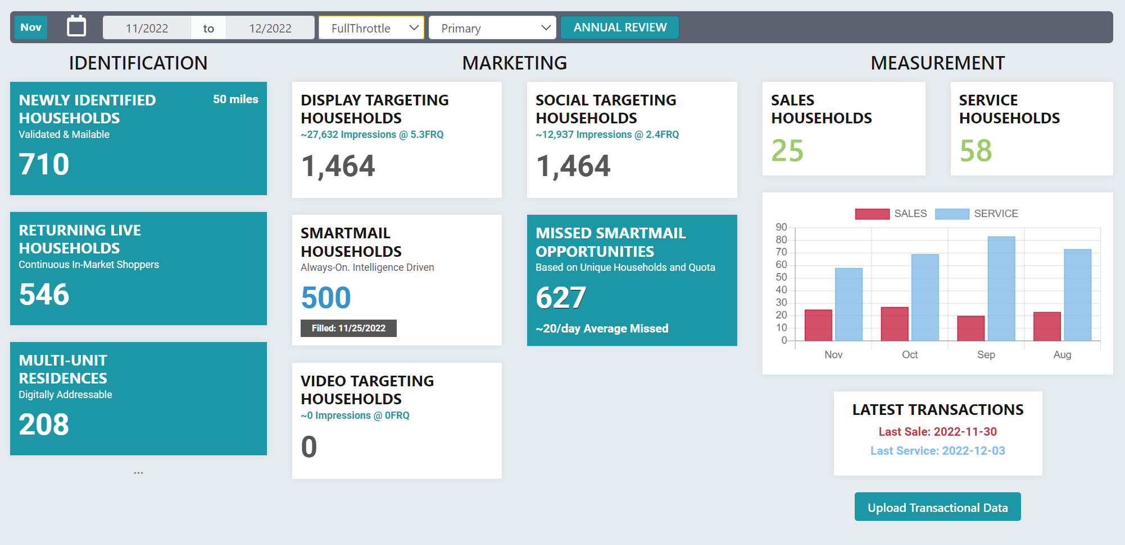
AUDIENCE ACTIVATOR
Comprehensive Reporting
Matched transactions to targeted households

Slide 10
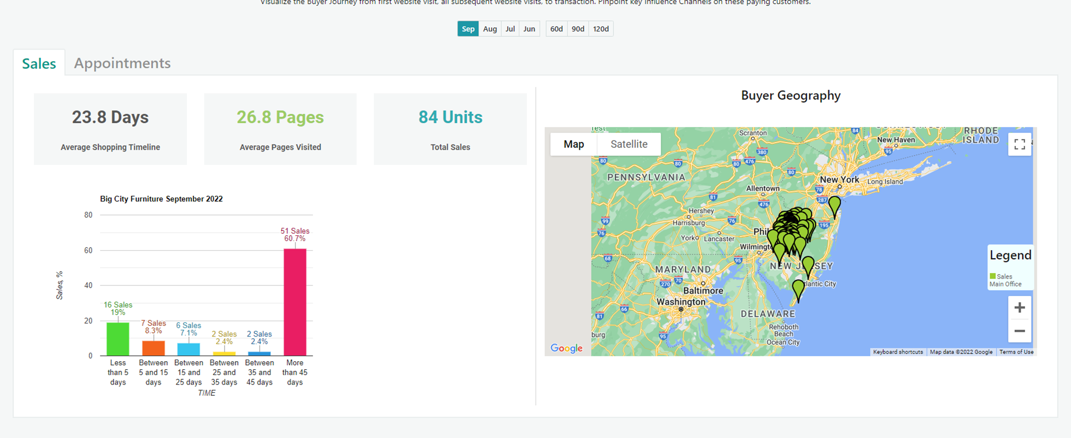
Client Dashboard | Analytics & Transactions
Based on transaction data we measure the "time to sale"
Breakout % of total sales by timeframe
Transactional households and company location

Slide 11
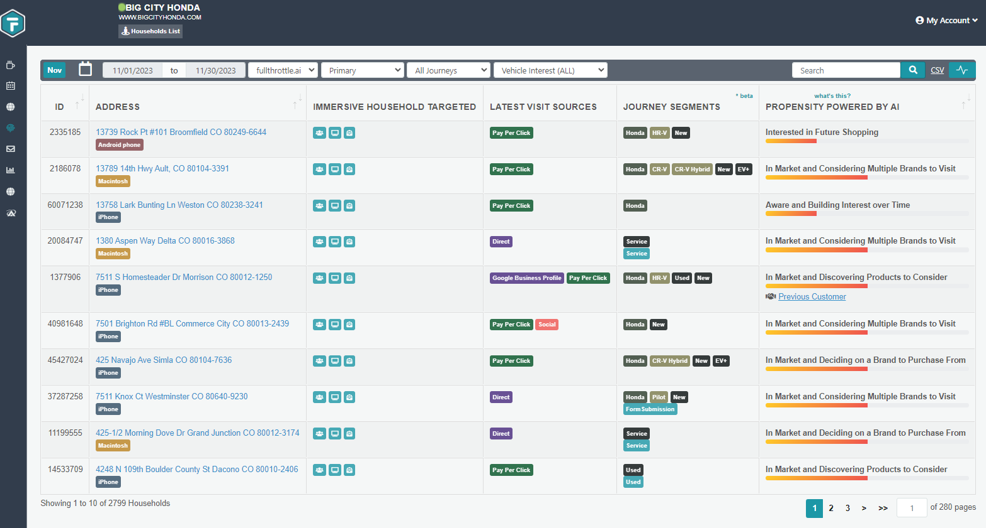
WEBSITE AUDIENCES TRANSFORMED INTO HOUSEHOLDS
DEPLOYED MEDIA TACTICS
RECENT AD INTERACTIONS
SEGMENT BY YEAR, MAKE, MODEL
SEGMENT BY SALE PROPENSITY (via AI Scale)

Slide 12
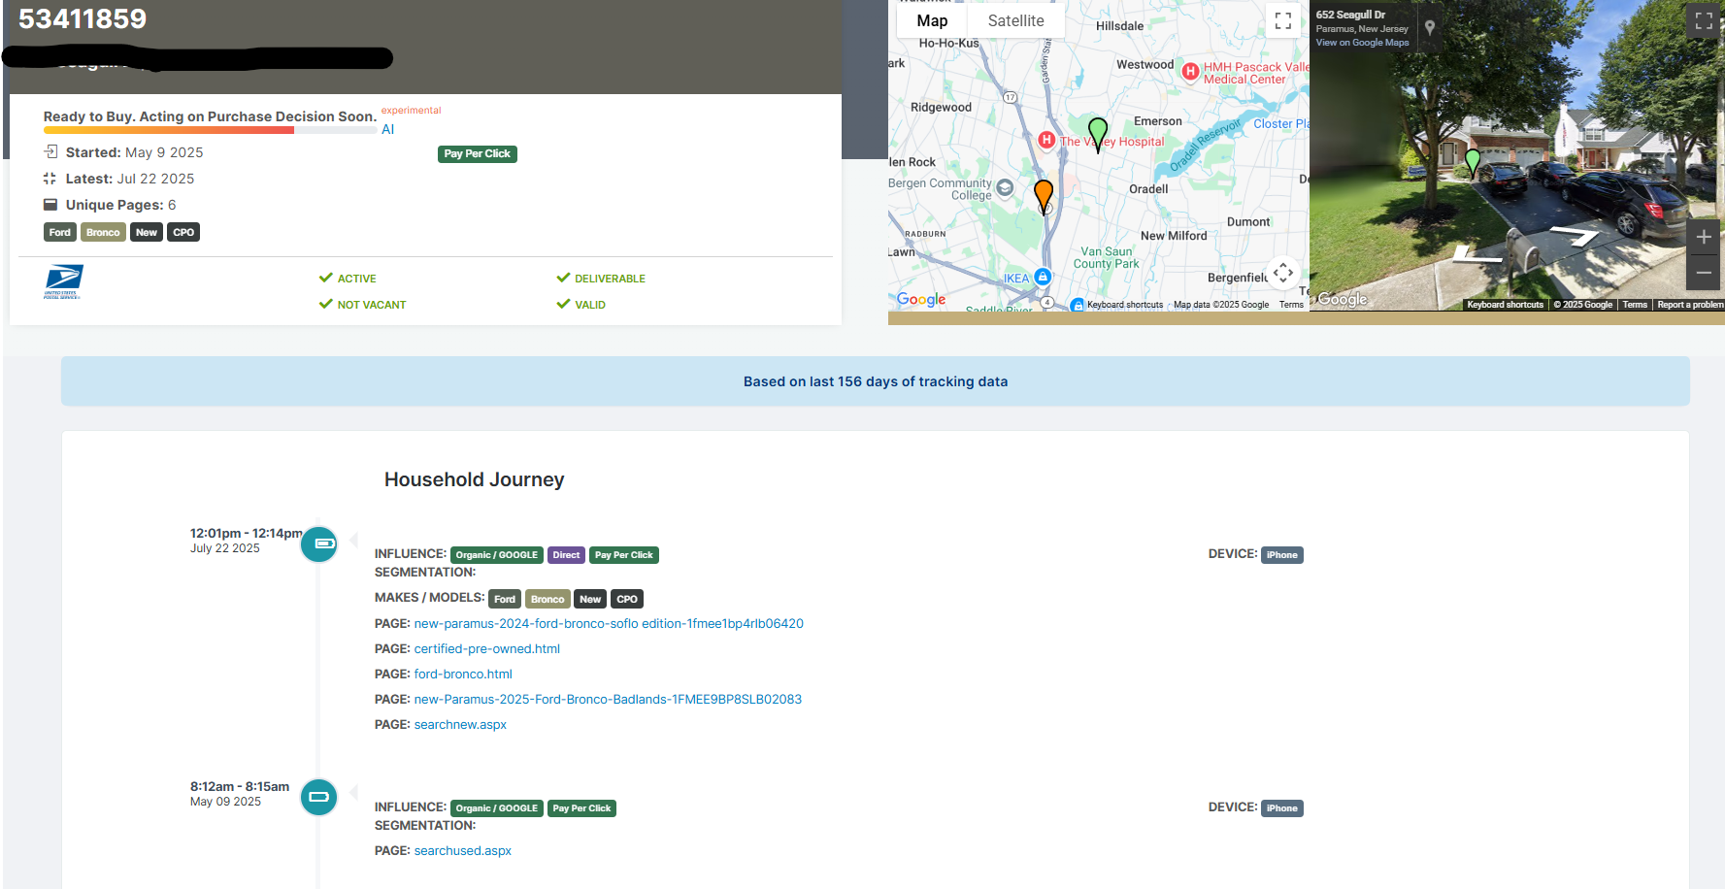
AUDIENCE ACTIVATOR

Slide 13
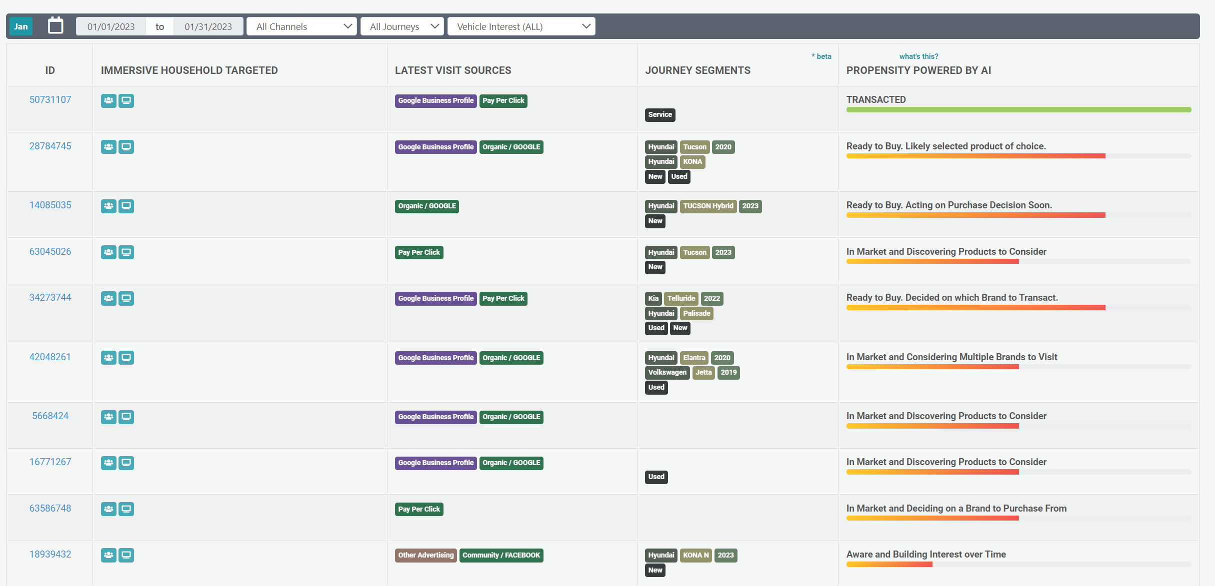
AUDIENCE ACTIVATOR
Household Level Data
Influence – what brought them, when they came, date opted in
Unique data points for predictability
Notes:
We provide fully-transparent and segmented household data.
The latest visit sources provides a full-funnel view of potential/current customers.
Our AI tracks user engagement and categorizes your leads based on propensity to buy.

Slide 14
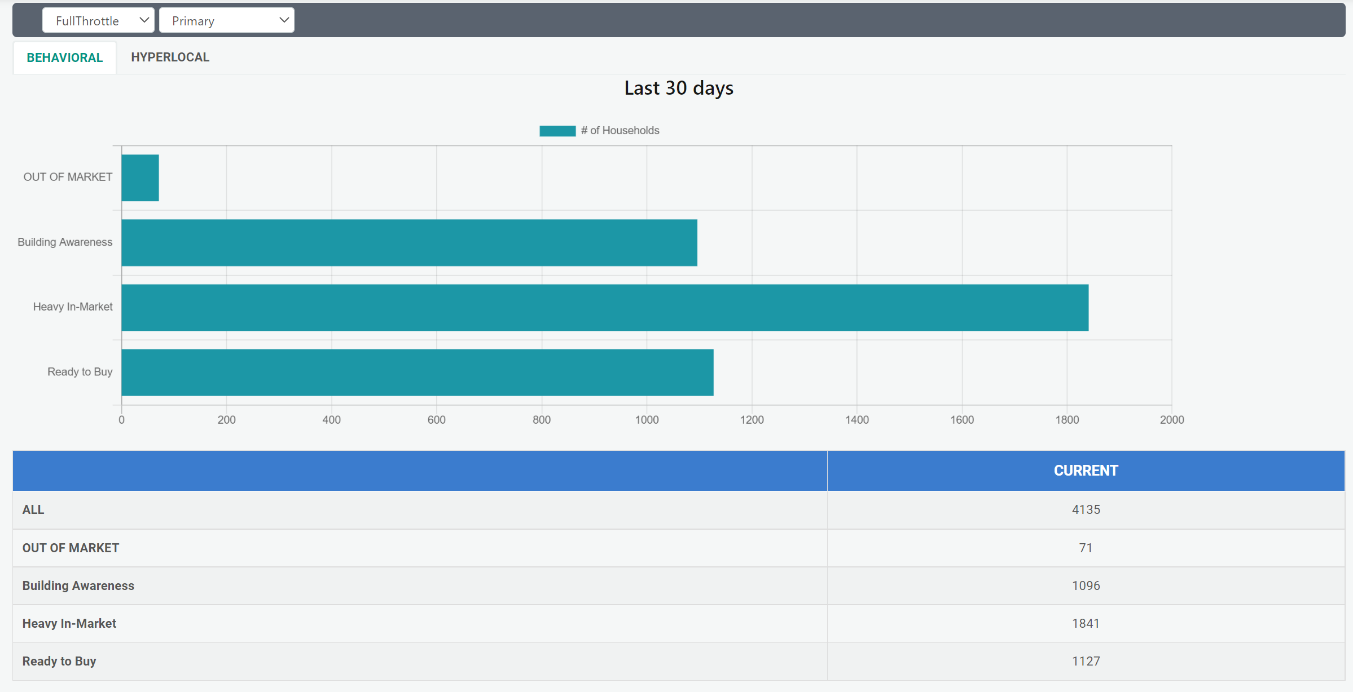
AUDIENCE ACTIVATOR
AI Audience Segmentation
Notes:
Your platform will detail audience segments and customer journeys.

Slide 15
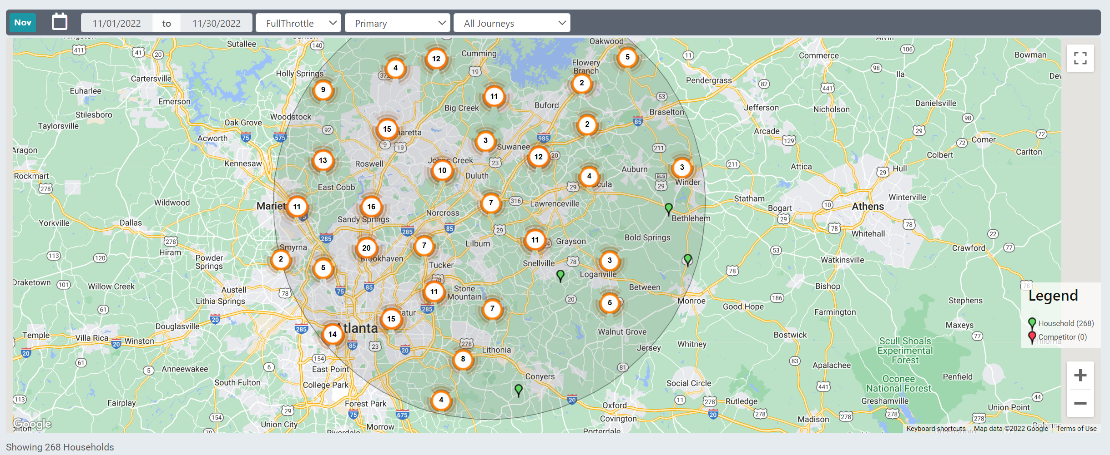
AUDIENCE ACTIVATOR
Map Views & Journey Segments
Notes:
View at the household level or expand for a neighborhood, city, region, or national view of your potential customers.

Slide 16
DATA ANALYSIS TRIAL
Start gaining insights
Start with a TRIAL analysis period that includes complete onboarding & software configuration.
  No marketing is launched during the data analysis period
FullThrottle's script is installed on client website, and it will begin prompting users to opt in and share their location at the browser level.
Next, FullThrottle's patent-pending household identity resolution technology will begin transforming website visitors into first-party data down to the household level.
Three to four weeks after launch, our team of experts will meet with you to analyze your results and discuss marketing strategies to help you increase conversions and sales.

Slide 17


