Slide 1
Automotive
Case Studies:

Slide 2
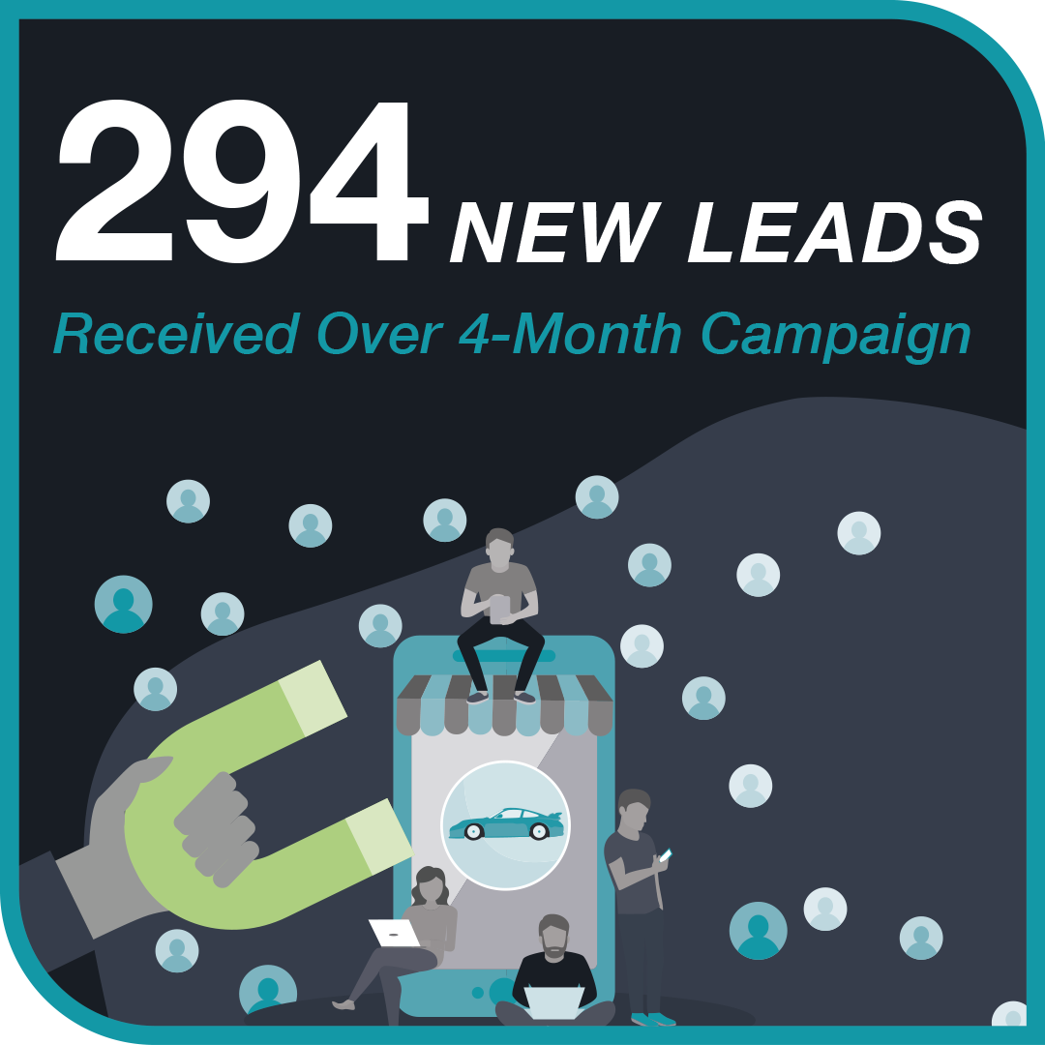
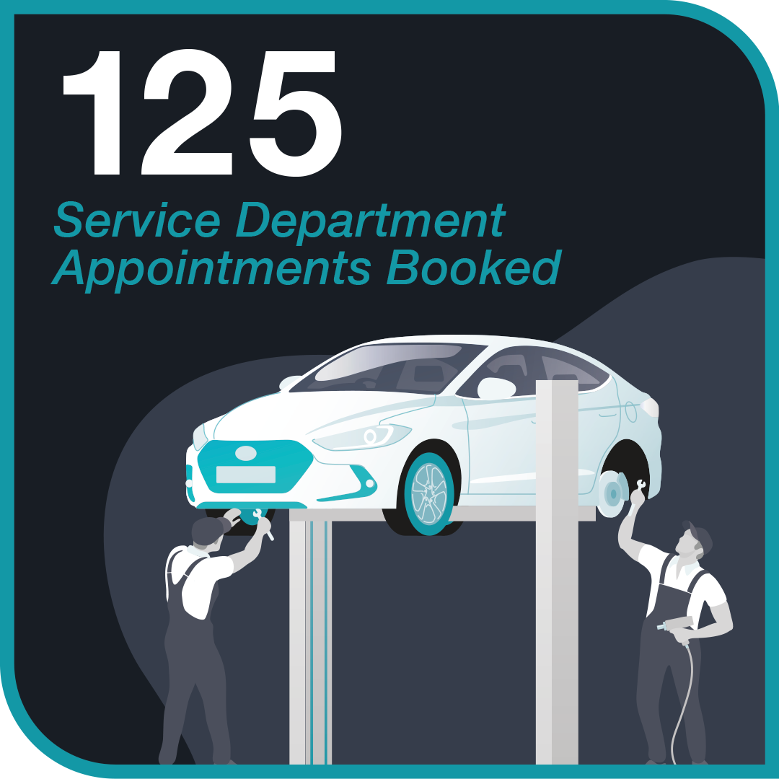
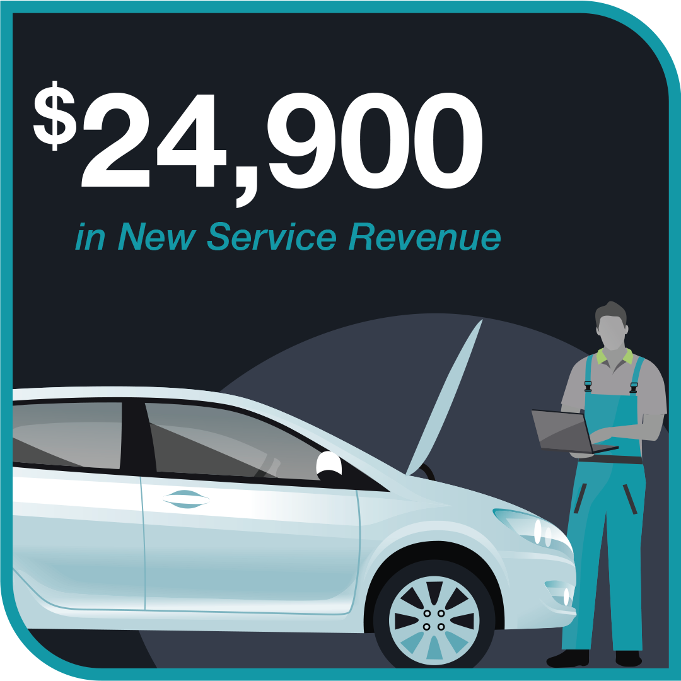
Automotive Dealership Boosts Lead Quality and Service Revenue with fullthrottle.ai™
Case Study:
Challenge:
An automotive dealership faced challenges with generating highquality leads and increasing conversions. Operating in a single market, they needed an effective solution to boost both lead volume and the quality of prospects, resulting in a direct impact on their overall conversions and service revenue.
Tactics & Results:
Using fullthrottle.ai's Lead Generation, the client saw impressive results over a four-month campaign, driving significant value for their service department. They were able to average 3 net-new leads per day in a one-month period, and 43% of the new leads submitted translated into services showcasing the high quality of the leads generated.
By performing a match-back analysis covering the campaign duration, fullthrottle.ai™ confirmed the direct correlation between targeted advertising efforts and lead generation, providing the client with quantifiable proof of their ROI.

Slide 3
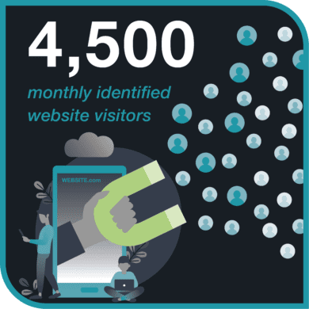
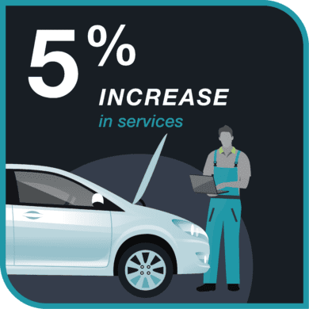
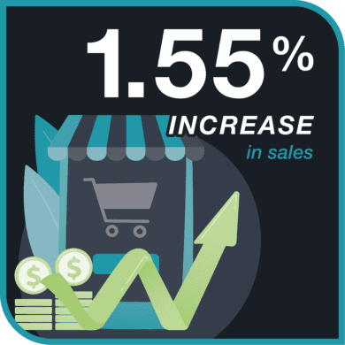
BMW of Sterling Increases Sales and Service Revenue with fullthrottle.ai™
Case Study:
Challenge:
BMW of Sterling, a single-market luxury dealership, had a goal to establish a strong brand message around their expansive EV service bays. In order to display themselves as the electric authority for BMW, they needed unique ways to send targeted advertising to their prospective customers and be able to tie it back to ROI and ROAS.
Tactics & Results:
By leveraging fullthrottle.ai’s patented technology, BMW of Sterling gained new insights into their marketing and sales attribution. These insights included matching customers who visited their website and came into the dealership as well as identifying in-market customers looking for luxury electric vehicles near their dealership.
The dealership was able to see month-over-month growth and directly attribute their increase in sales and services through matchbacks of their in-market targeted audience within our platform.

Slide 4
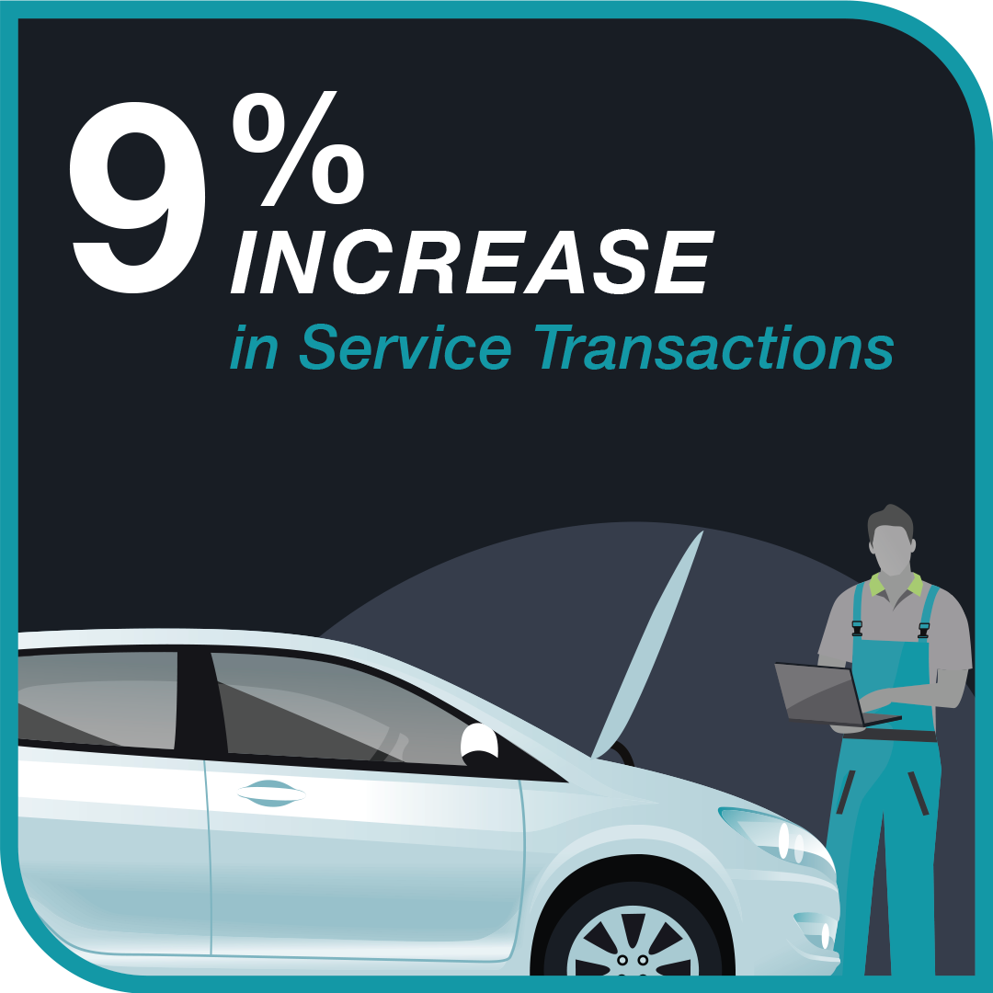
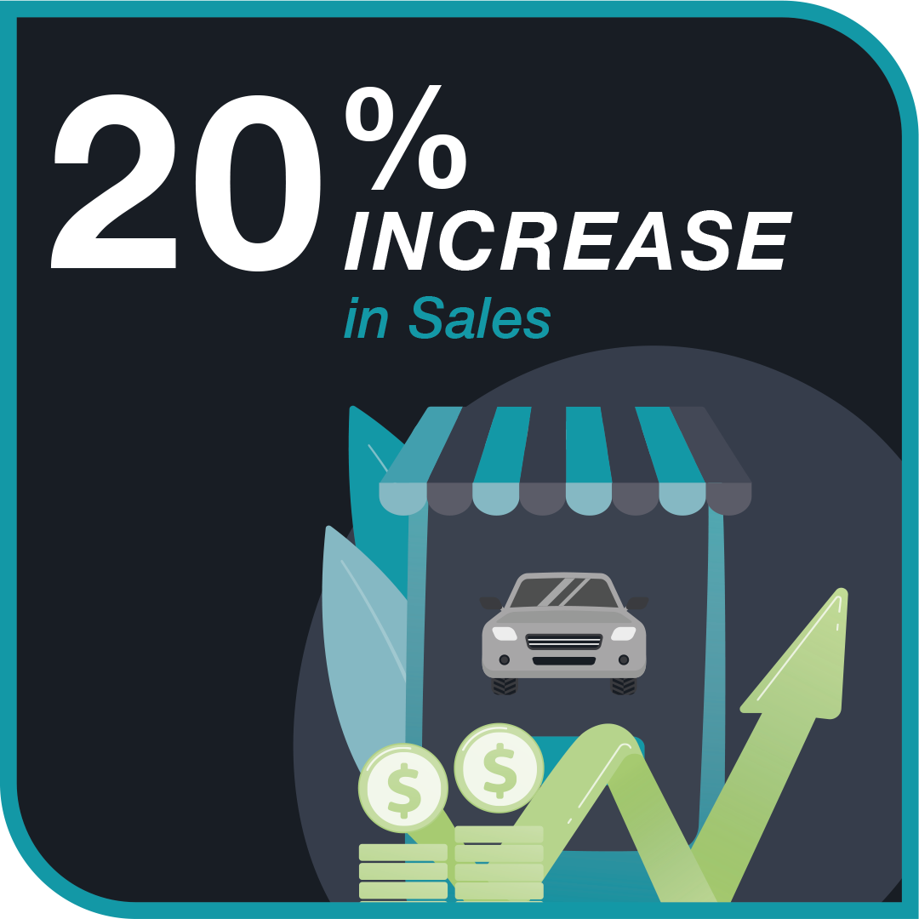
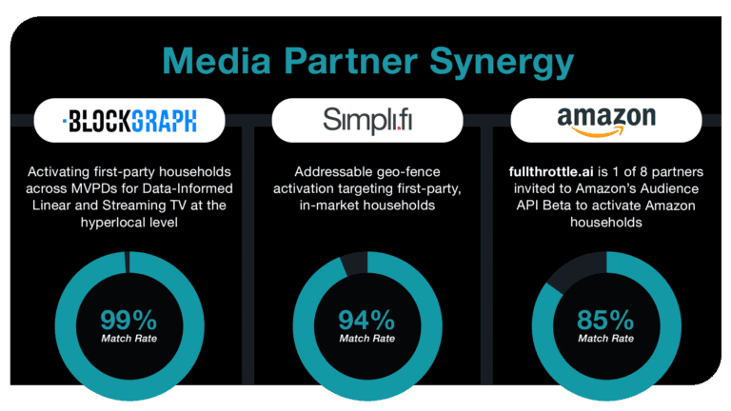
Automotive Dealership Sees 20% Sales Increase Using fullthrottle.ai™
Case Study:
Challenge:
An automotive dealer servicing the Tampa, Florida market faced a unique challenge. They aimed to gain market share by leaning deeper into data-driven media while many other dealers were cutting ad spend.
The dealership sought to drive efficiencies and prove the scalability of a first-party addressable TV targeting solution at the hyperlocal level.
Tactics:
The automotive dealership utilized fullthrottle.ai™ to build a first-party audience, which served as the basis for their media strategy. In collaboration with Blockgraph, this data was used to develop customized media plans for both Linear and Streaming TV. Targeting was fine-tuned to specific cable zones and zip codes, and success was gauged by KPIs focused on revenue from vehicle sales and service appointments.
The partnership enabled first-party audiences to be securely matched to households in a privacy-safe way, maximizing match rates and audience fidelity. The campaign proved that it’s possible to scale first-party data for use in video at the hyperlocal zip code level.

Slide 5
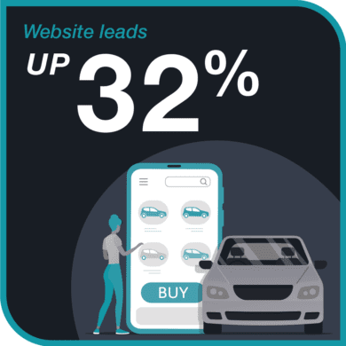
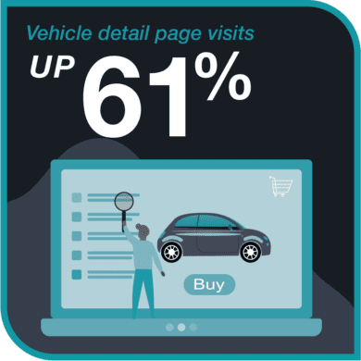
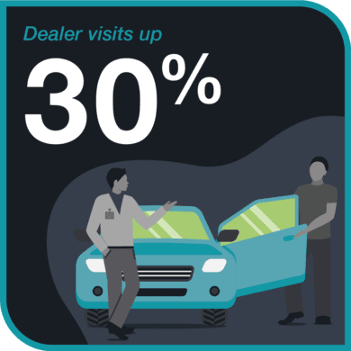
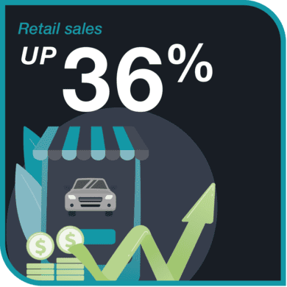
fullthrottle.ai’s AdTech Uses Data-Informed Campaigns to Prove Incrementality
Case Study:
Challenge:
Using fullthrottle.ai’s data-informed media strategies and tactics, we went head-to-head against a National OEM program and benchmarked our results against theirs. We leveraged fullthrottle.ai’s ad technology for our campaigns using the best-in-market audience data for unbelievable results.
Results:
In regions using our data-informed campaigns, our results were higher AND trended upwards --- while the results trended down in regions not leveraging our AdTech. We saw sales and traffic incrementality in the regions we focused on. These results have been consistent within other campaigns and across multiple markets.

Slide 6
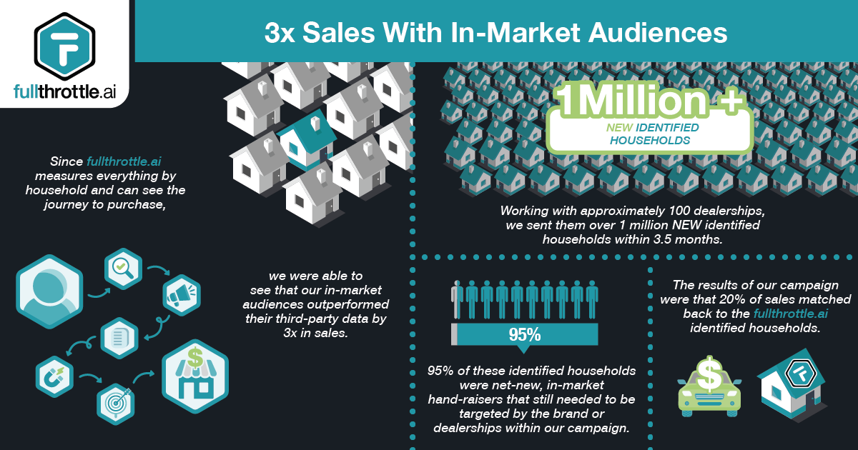
fullthrottle.ai’s In-Market Audiences Outperform
Third-Party Data by 3x in Sales
Case Study:
A large domestic automotive brand needed better capabilities for tracking attribution within their marketing campaigns in order to increase their advertising results.
They were partnered with one of the largest advertising agencies and wanted to discover new ways to amplify their marketing strategies for higher matchback rates and increased sales.
Our solution to building net-new audiences of incremental data can be customized to fit your marketing strategy, whether you market in-house or use an outside agency.
fullthrottle.ai’s fresh and accurate data sets help you get the most from your campaigns if you’re running retargeting.

Slide 7
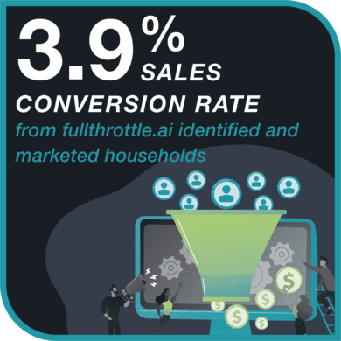
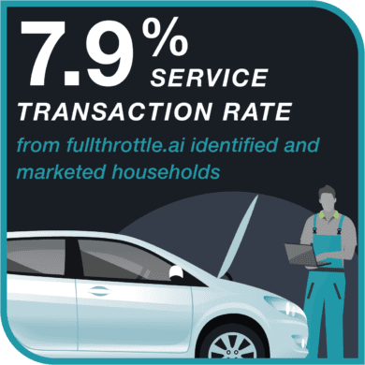
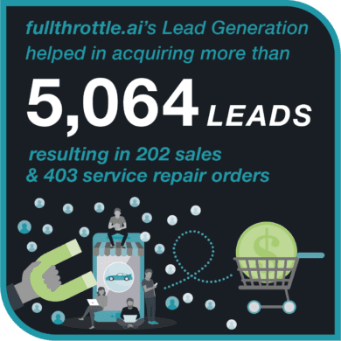
fullthrottle.ai’s Lead Generation Boosted Showroom Visits and Sales for an Automotive Manufacturer
Case Study:
Challenge:
A manufacturer was determined to improve leads and showroom foot traffic through a website promotion. The challenge lay in not only attracting leads, but in transforming them into real business transactions. They wanted to know which website leads from the promotion would result in customers, either through a sale or a service transaction.
Tactics:
Using fullthrottle.ai’s Lead Generation rewards program, an on-site promotion tool designed to create excitement for interested website visitors, they incentivized potential customers to submit their information and then pushed this data instantly into the manufacturer's CRM.
The manufacturer sent incentivized SMS texts, instant emails that included mobile-friendly printable coupon codes, and weekly emails delivered to people with unredeemed promotions. By employing this innovative approach, the manufacturer not only increased leads, but successfully converted them into sales and service transactions, yielding real and quantifiable value.

